Slide 1
Detecting Sarcasm in Text
Calvin Choi, 500277848

Slide 2
“A way of using words that are the opposite of what you mean in order to be unpleasant”. - Oxford Advanced American Dictionary

Slide 3
Challenge
Detecting sarcasm is important for many groups, including companies, agencies, institutions, political groups, etc.
Simply using text itself may not be feasible due to liquistic nuances of sarcastic phrases.
Develop a model that can accurately differentiate sarcastic text from non-sarcastic text through feature engineering and text preprocessing which can be universally used across many social mediums.

Slide 4
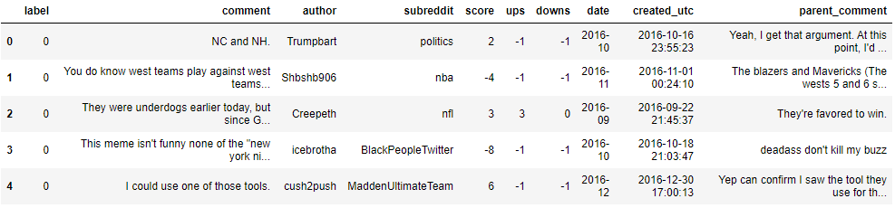
Data
1,010,774 comments scraped from Reddit
Pre-labelled and balanced (1 = sarcastic, 0 = non-sarcastic)
Reduced to 50,000 comments for modelling
Only ‘comment’ feature is used

Slide 5
Approach
Exploratory Data Analysis
Feature Engineering
Classification Analysis
Text Preprocessing

Slide 6
Exploratory Data Analysis (EDA)
EDA categorized into 3 areas:
Analysis of bigrams and trigrams.
The structure of comments
Parts of speech (POS) and named entity recognition (NER)

Slide 7
EDA – Analysis of Bigrams and Trigrams
BIGRAMS
i’m sure (5180)
i think (4991)
i thought (2936)
you forgot (2819)
i know (2449)
i guess (2281)
sounds like (1959)
i can’t (1804)
i see (1593)
good thing (1566)
TRIGRAMS
but i thought (534)
i'm pretty sure (449)
i think forgot (434)
i can't wait (423)
you dropped this: (344)
i think dropped (318)
i guess i (317)
yeah i'm sure (312)
i can't believe (310)
you sound like (236)

Slide 8
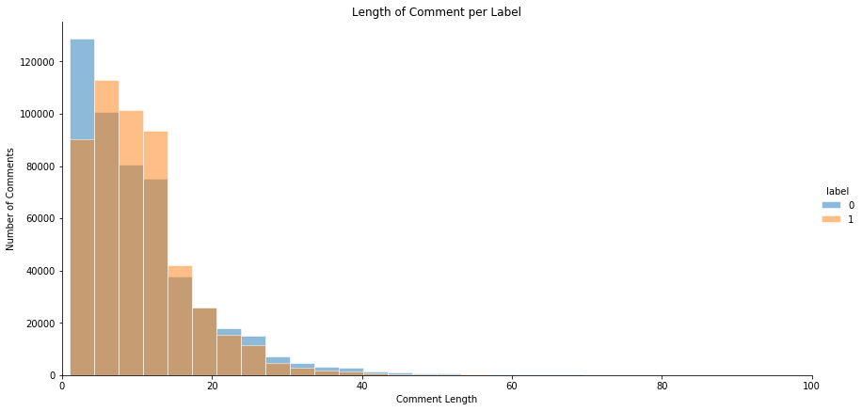
EDA – The Structure of Comments

Slide 9
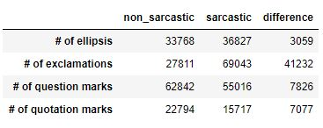
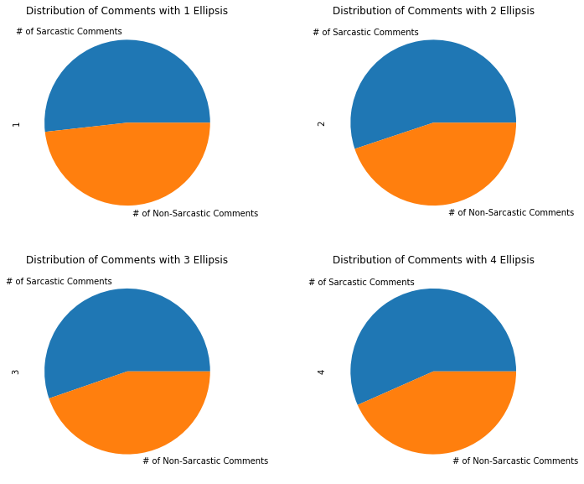
EDA – The Structure of Comments
4 Types of Punctuations Observed:
Ellipses (…)
Exclamation Marks (!)
Question Marks (?)
Quotation Marks (“ ”)

Slide 10
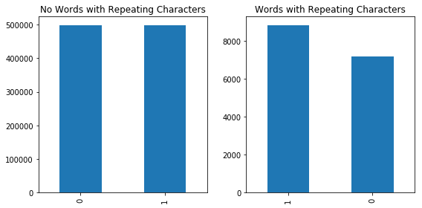
EDA – The Structure of Comments
Other features considered:
Features describing humor - lol, haha, :)
Number of repeating characters:
“Oooo you’re so edgy putting that here” = 4 repeating characters

Slide 11
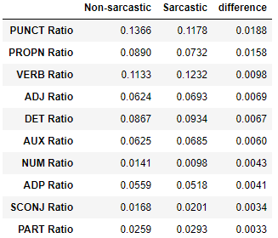
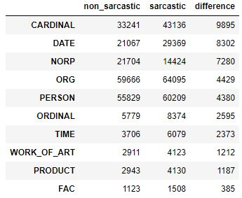
EDA – Parts of speech (POS) and named entity recognition (NER)
Used spaCy doc object to parse comments and assign POS and NER tags to each word.
POS tags indicate which parts of speech each word belongs to.
e.g. noun, verb, adjective, interjection
NER tags identify named entities in text.
e.g. person, companies, political groups, product, etc.
POS
NER

Slide 12
Text Preprocessing and Feature Engineering
Create pipeline to bind text preprocessing and feature engineering steps.
Steps are based on insights gathered from EDA stage.
Feature Pipeline
Text Preprocessing
Text normalization
Lemmatization
Bag-of-words and bag-of-bigrams
Tf-idf weights assigned
Feature Engineering
Number of words in comment
Number of ellipsis in comment
Number of exclamation marks in comment
Number of question marks in comment
Number of quotation marks in comment
Number of smiley face emoticons in comment
Number of repeating characters in comment

Slide 13
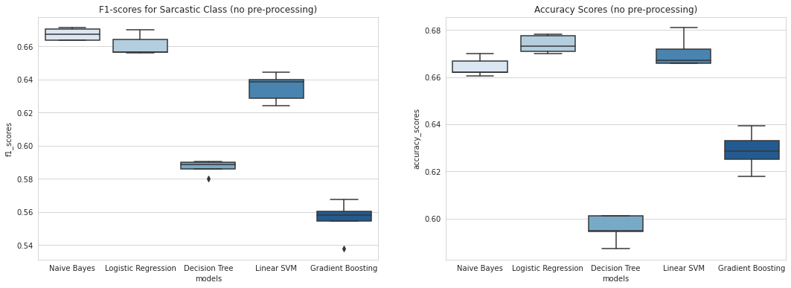
Preliminary Model Selection
First, evaluate preliminary classification models:
5-fold CV on bag-of-ngrams.
f1-score of sarcastic class and accuracy used to evaluate models.
Naïve Bayes and Logistic Regression score the highest.

Slide 14
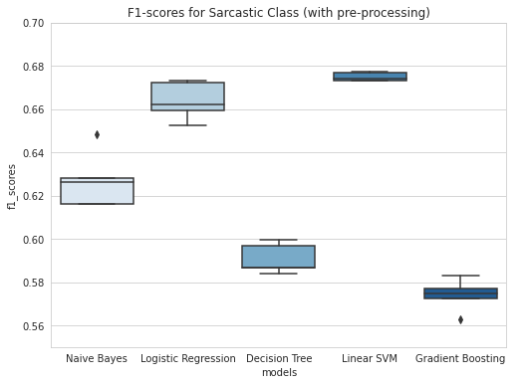
Evaluate Models using Pipeline
Re-run 5-fold CV with feature pipeline bound to each classifier.
Only Logistic Regression benefits from the added steps.

Slide 15
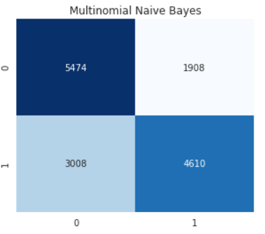
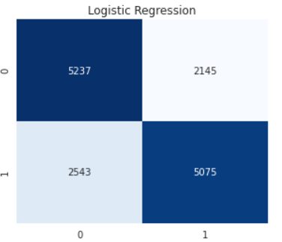
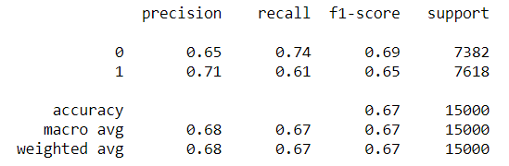
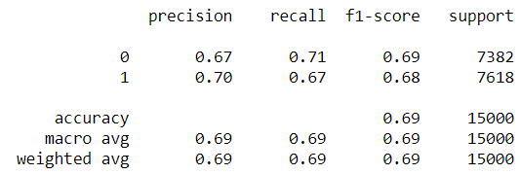
Results on Testing Set
Test Naïve Bayes and Logistic Regression model on hold-out set.
Results:

Slide 16
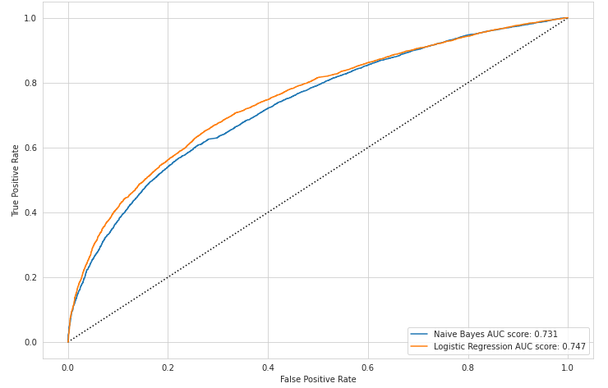
Final Evaluation: ROC-AUC
Receiver operating characteristic (ROC) and Area under the Curve (AUC) score used as final evaluation metric.
ROC helps visualize the models’ true positive rate vs. false positive rate.
AUC score summarizes each curve by measuring the area under it – the higher the score, the stronger the model.
Logistic Regression is the stronger model, with AUC of 0.747

Slide 17
Conclusions
Preprocessing included bag-of-ngrams, lemmatization, and normalization
Feature engineering included word count, punctuation and special characters count.
Other than Logistic Regression, the text preprocessing and feature engineering did not result in stronger models.
Strongest model not very accurate with recall of 66-67% and 70% precision.
Would not recommend utilizing model in real-world setting.

Slide 18
References
Ashwin Rajadesingan, Reza Zafarani, and Huan Liu, (2015). Sarcasm Detection on Twitter, A Behavioral Modeling Approach
Francesco Barbieri, Horacio Saggion, and Francesco Ronzano, (2014). Modelling Sarcasm in Twitter, a Novel Approach
Natalie Parde and Rodney D. Nielsen, (2018). Detecting Sarcasm is Extremely Easy ;-)
Ellen Riloff, Ashequl Qadir, Prafulla Surve, Lalindra De Silva, Nathan Gilbert, and Ruihong Huang, (2013). Sarcasm as Contrast between a Positive Sentiment and Negative Situation
Tomas Ptacek, Ivan Haberbal, and Jun Hong, (2014). Sarcasm Detection on Czech and English Twitter

Slide 19
Questions?

